Slide 1


Welcome…

Slide 2
Project Name : Cake Shop
Presented By : Sarode onkar balasaheb

Slide 3
INDEX
Introduction
Scope of Project
Purpose
Main Operation
Input Output Operation
Conclusion
System Requirement
Bilography and Webiblograph

Slide 4
INTRODUCTION
A bakery or cake shop I's a retail business Specializing in producing and for selling cakes, muffins Sponges, as well as of the baked goods that fall under the title of a cake.
cake shops many also sell equipment and Supplies for home cake baking, especially for care decorating.

Slide 5
SCOPE OF PROJECT
project Scope is the parameter of the project.
It defines What are the deliverable requirements and expectations for the Project and provide a baseline to exclude unrelated works.
And this process is referring to as the project scope management.

Slide 6
PURPOSE
cake shop is a bakery group that focuses on the production and Sales of cakes and pastry.
A high Supply reliability continues high quality a high level of Certification smart innovations f short development processes.

Slide 7
MAIN OPERATION
Shop Now
Home
Our shop
About
Contact

Slide 8
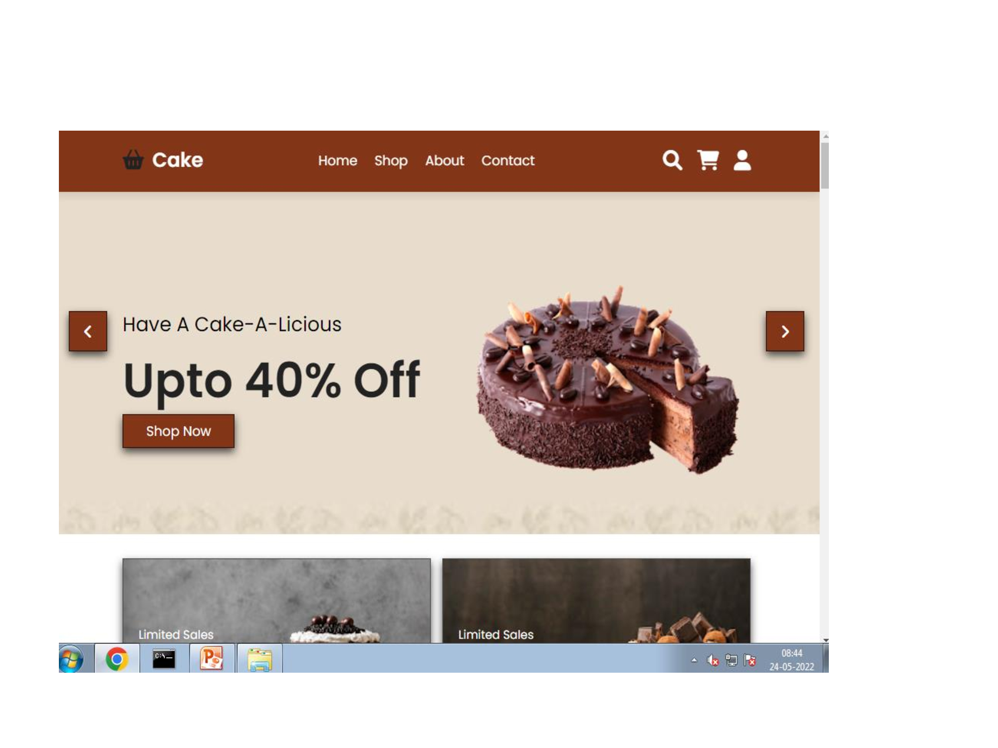
INPUT OUTPUT OPERATION

Slide 9
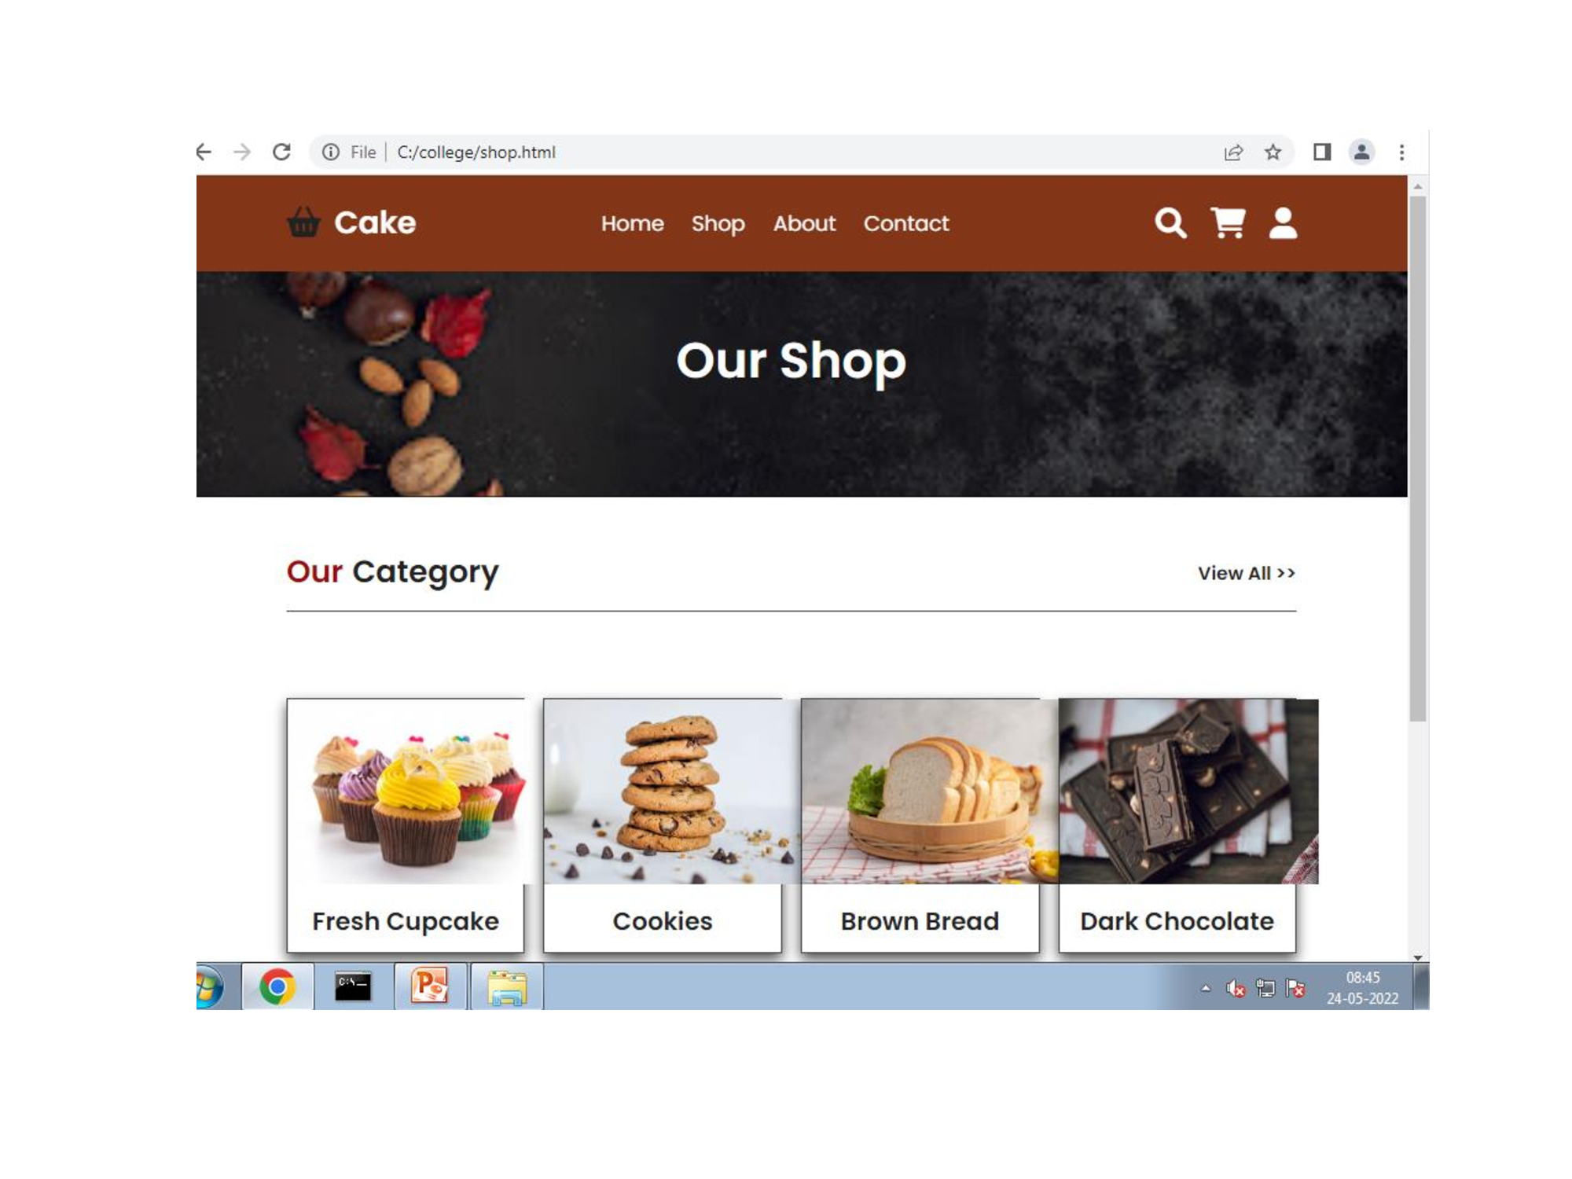

Slide 10
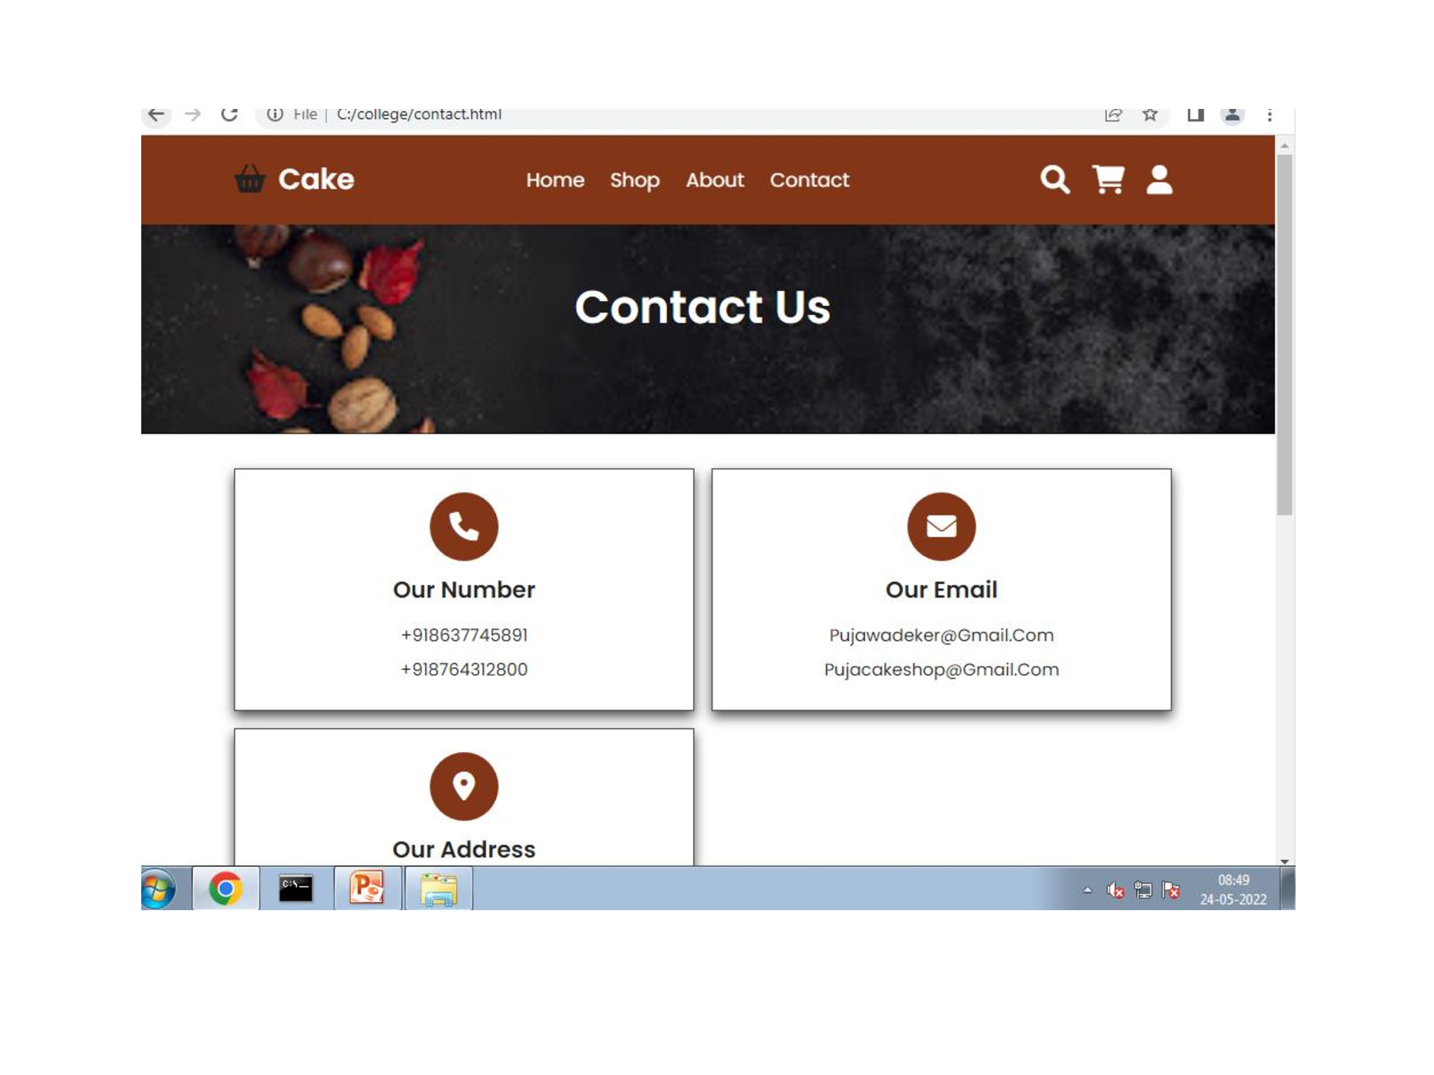

Slide 11
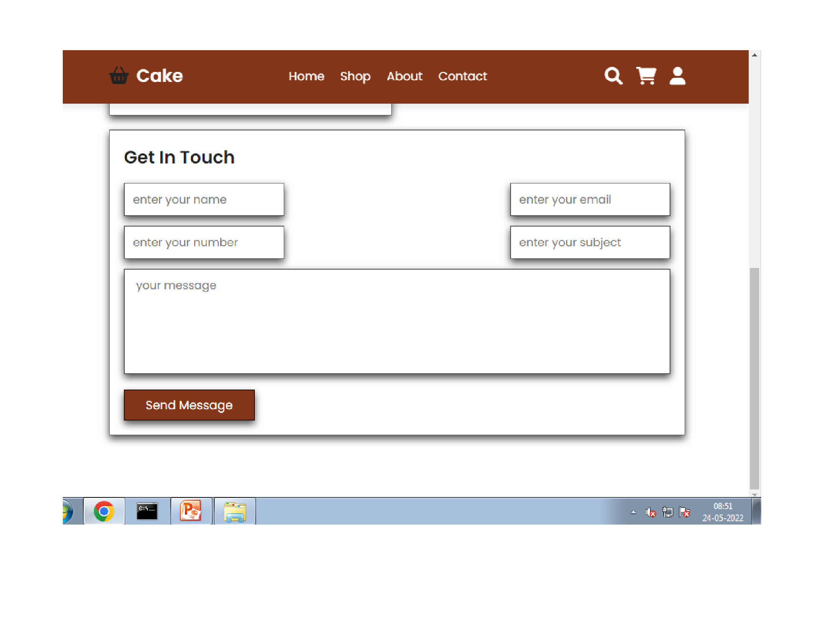

Slide 12
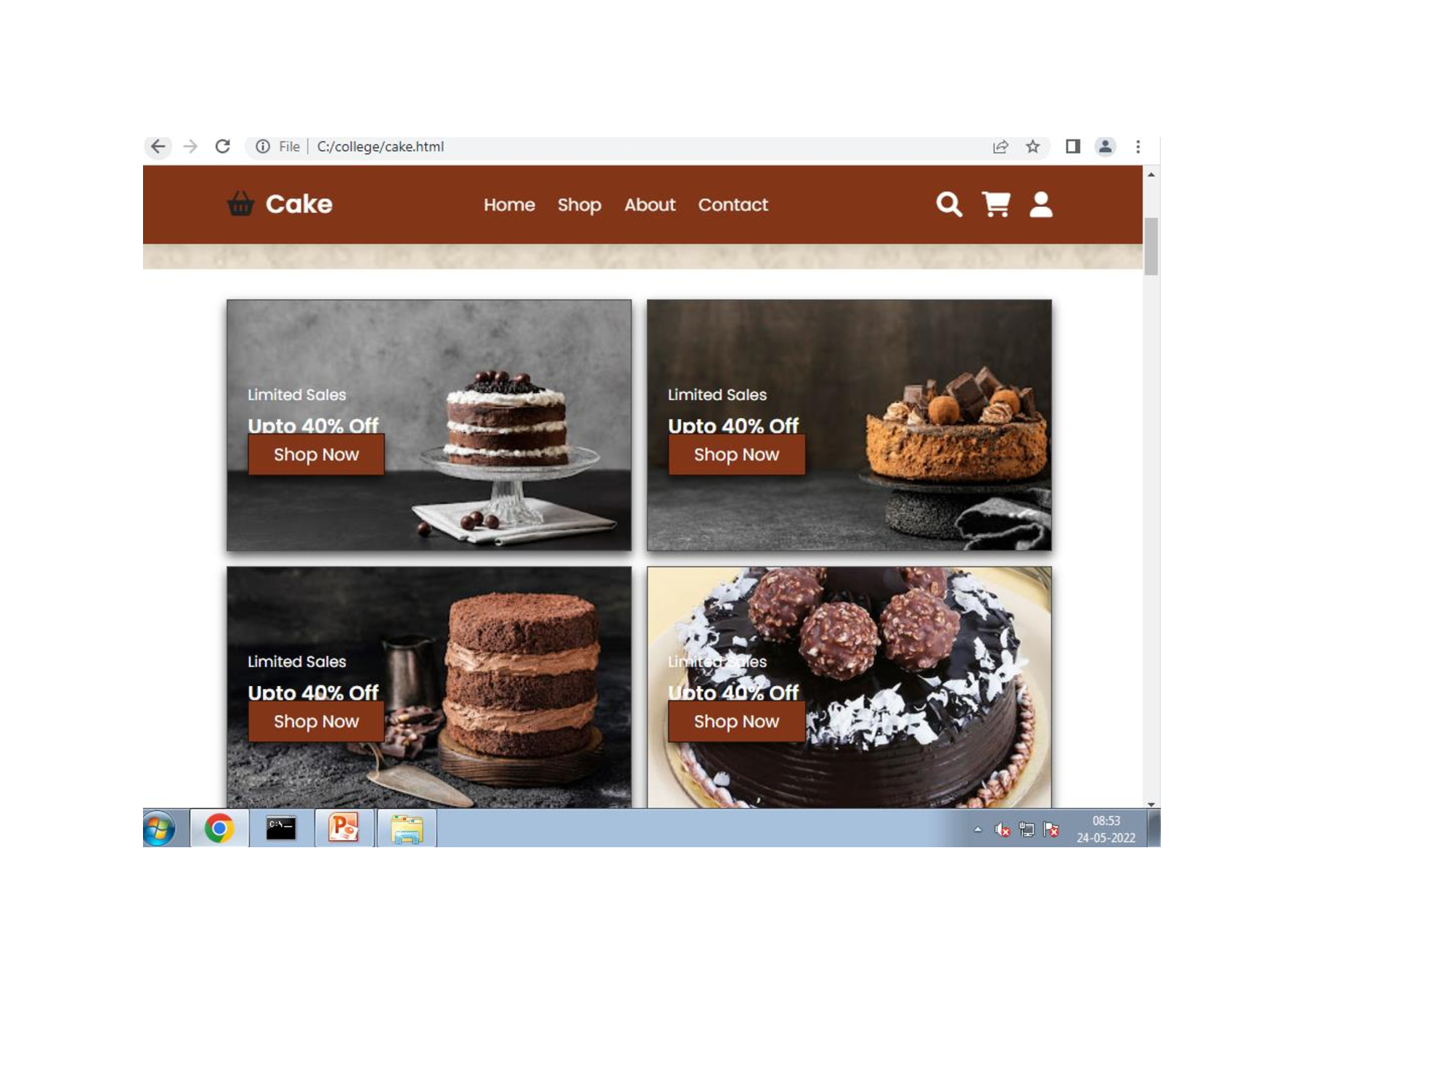

Slide 13
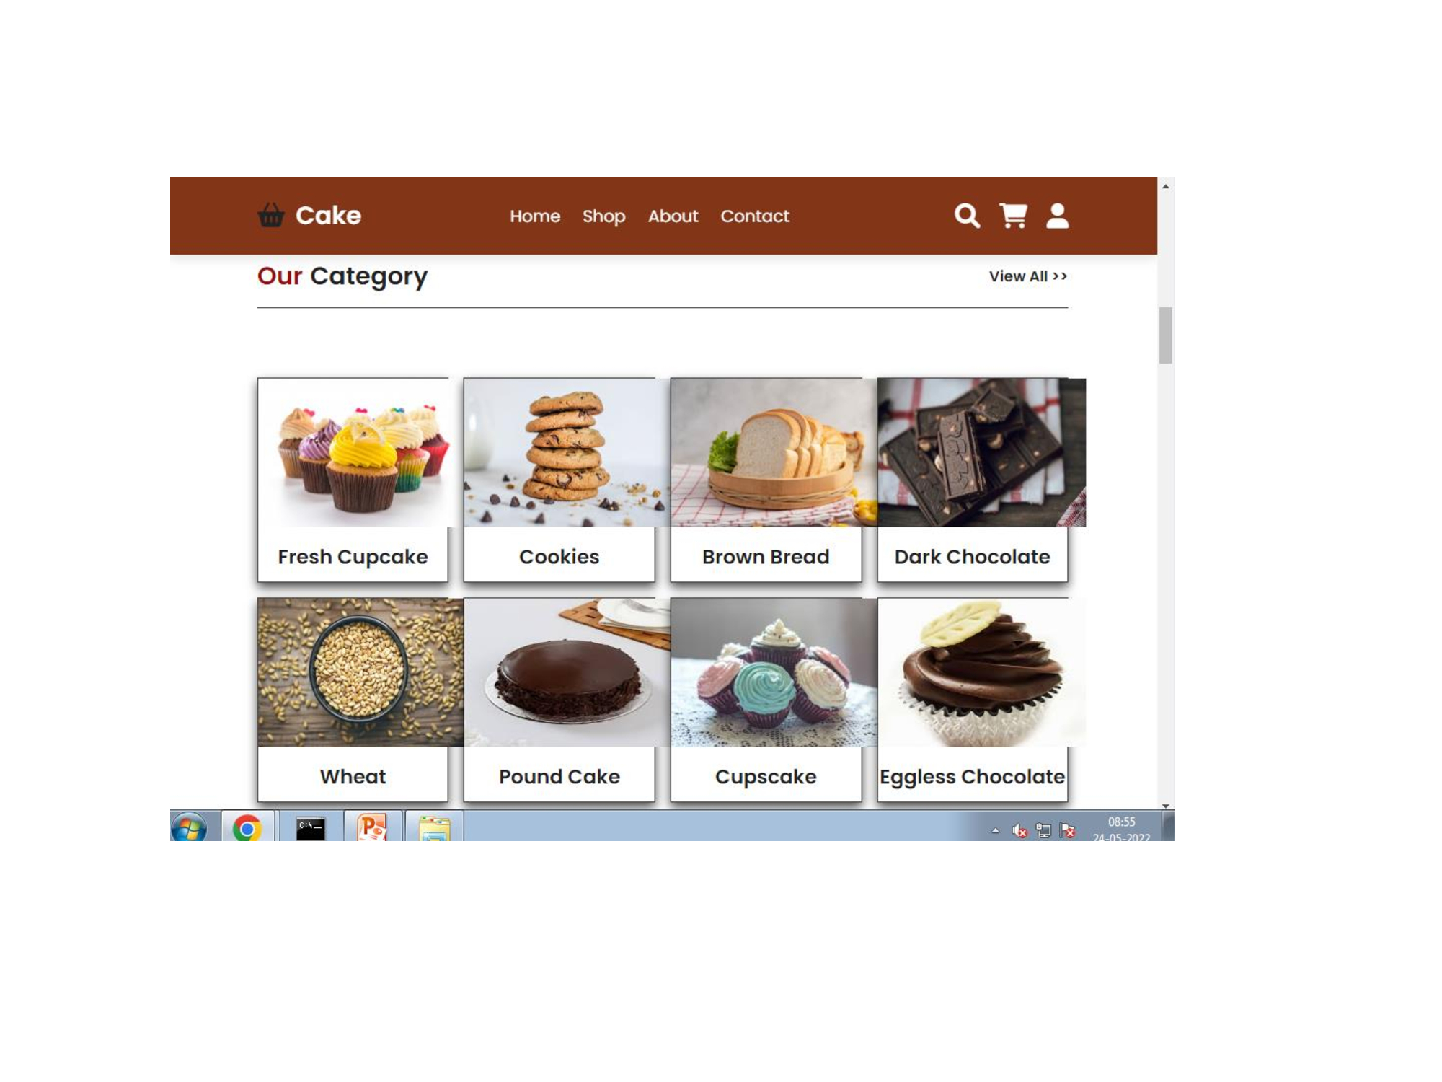

Slide 14
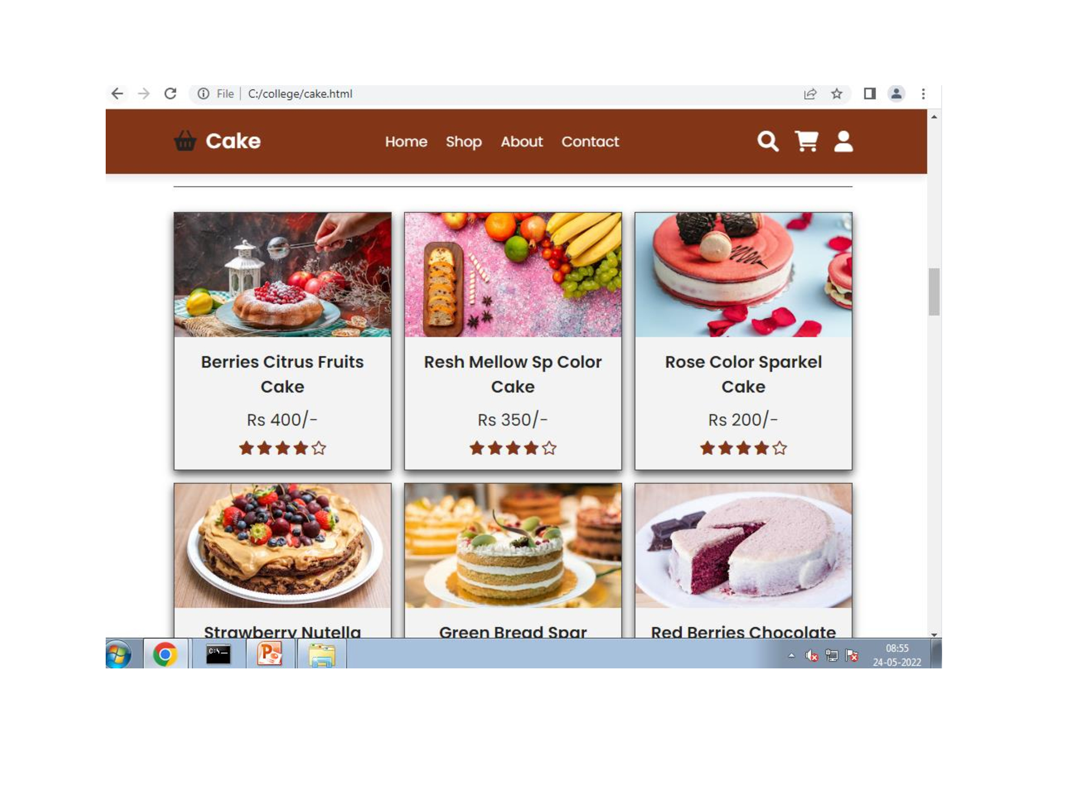

Slide 15
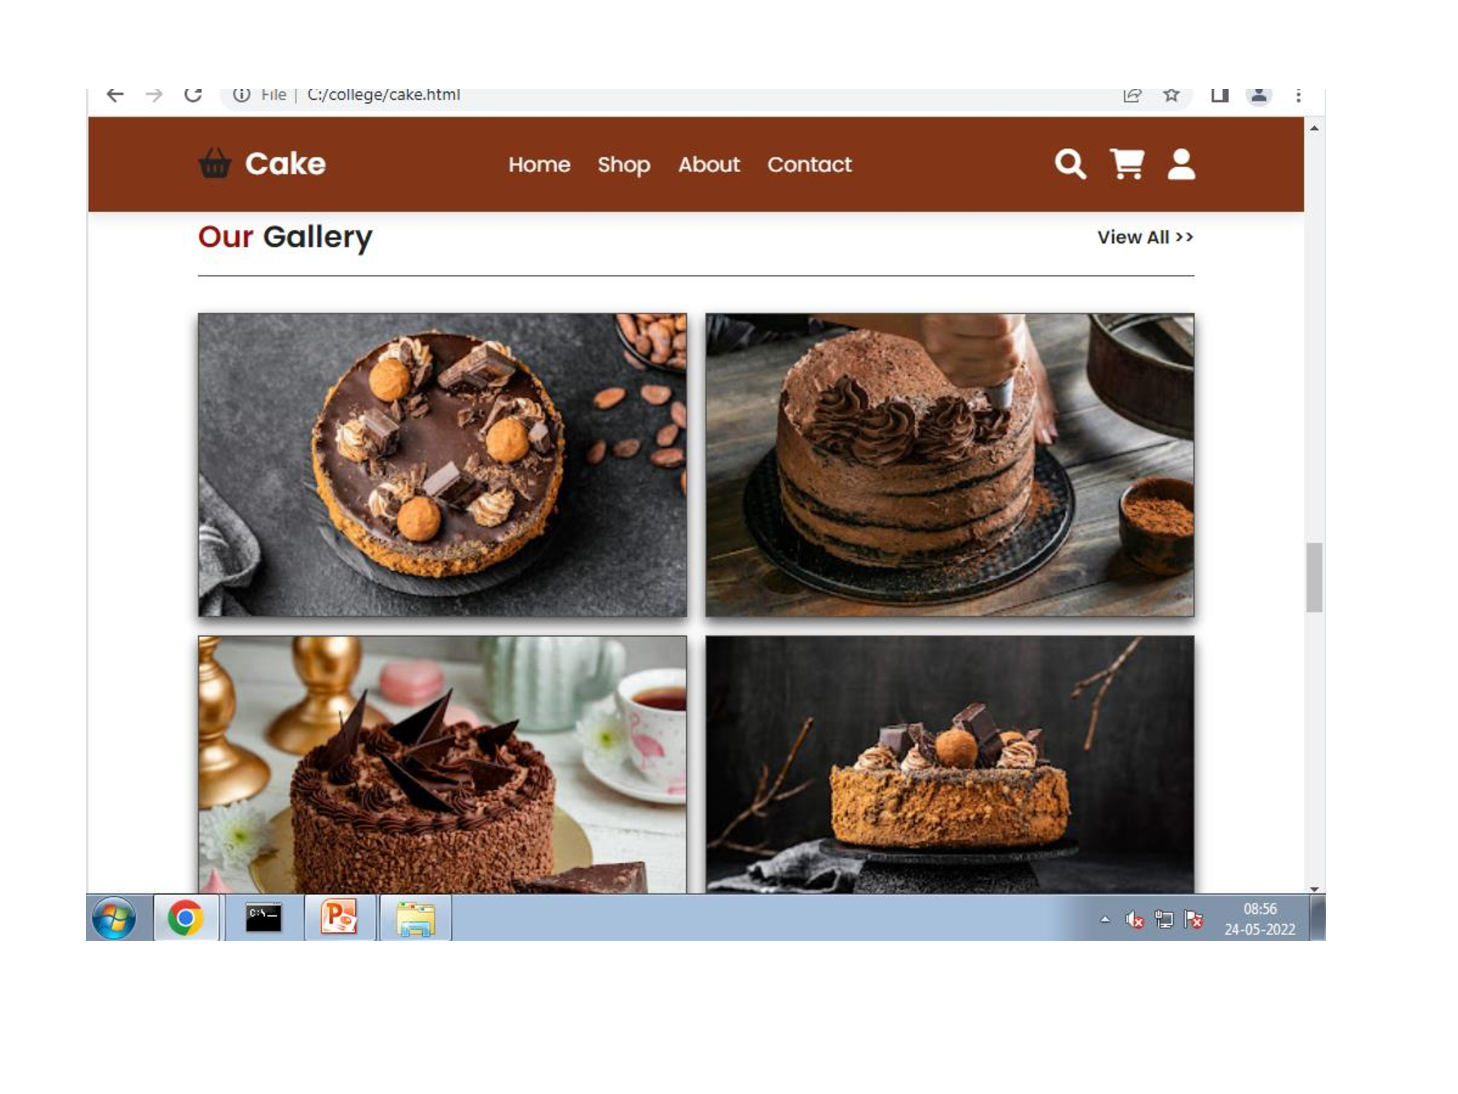

Slide 16
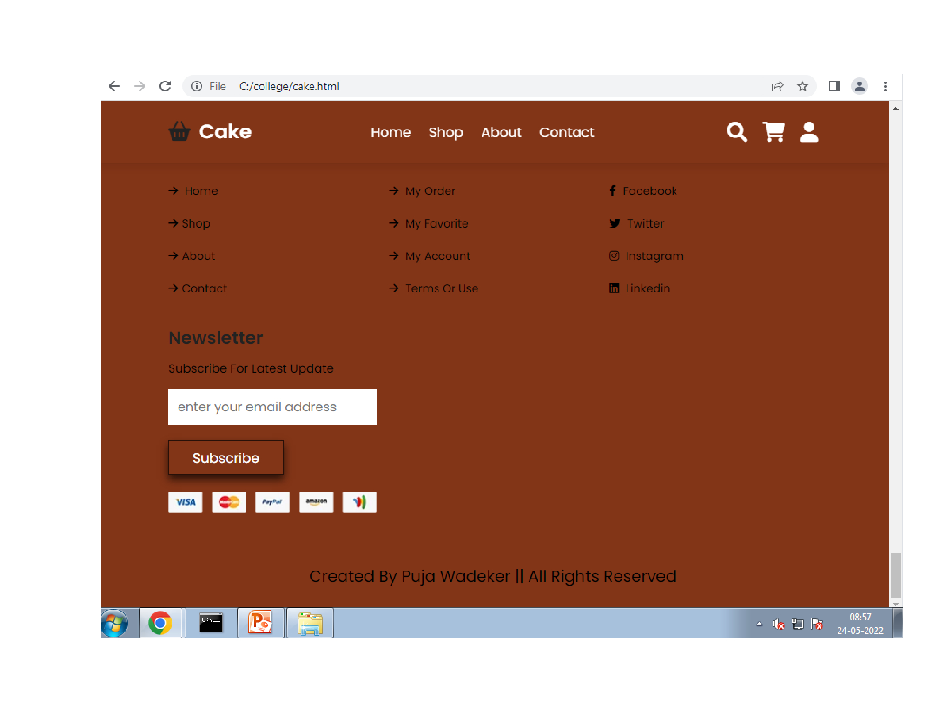

Slide 17
CONCLUSION
The project as a whole described the scope and viability of the trending industry and mainly of the financial technical and it's market potential.

Slide 18
SYSTEM REQUIREMENT
Hardware Requirement minimum : 1GB RAM
Software Requirements
Operating System : Windows
Frontend : HTML, CSS

Slide 19
BIBLIOGRAPHY and WEBLOGRAPHY
Bibliography :
The Complete Book of Backing.
Passionate About Baking.
Mary Berry’s Baking Bible.
Web Design with HTML and CSS.
Weblography :
https://www.w3schools.com
https://htmlcodex.com
https://themeforest.net

Slide 20
Thank You !

